Slide 1

AIDI 1006-Assignment #4 Sentiment Analysis Assignment
Group Members
Shivam Patel(200496356)
Arjun Pawar(200493035)

Slide 2




Project Architecture
SOURCES
INGESTION
ANALYSIS
VIZ
Dataset connected to Azure ML
Visualization using Power BI
Sentiment analysis

Slide 3
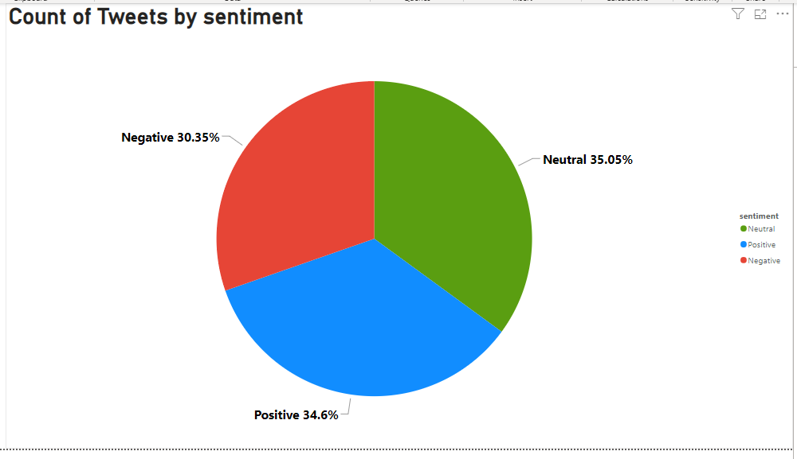

Slide 4


World Cloud

Slide 5
